Slide 1
Release Demo Plugin

Slide 2
Purpose
Allows rapid customization, customer name and applications
Shows most of the Flow Release features

Slide 3
Model Walk Through

Slide 4
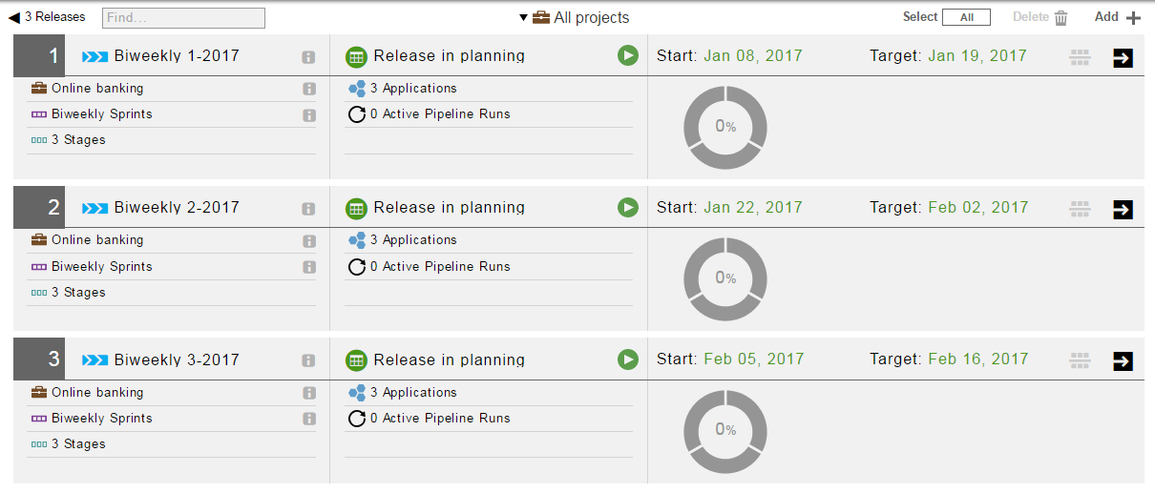
Sample Releases

Slide 5
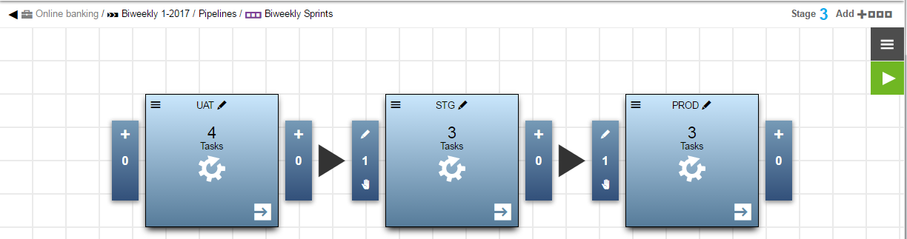
Pipeline

Slide 6
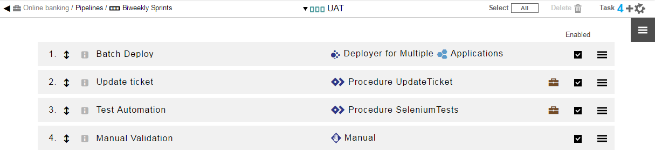
First Stage

Slide 7
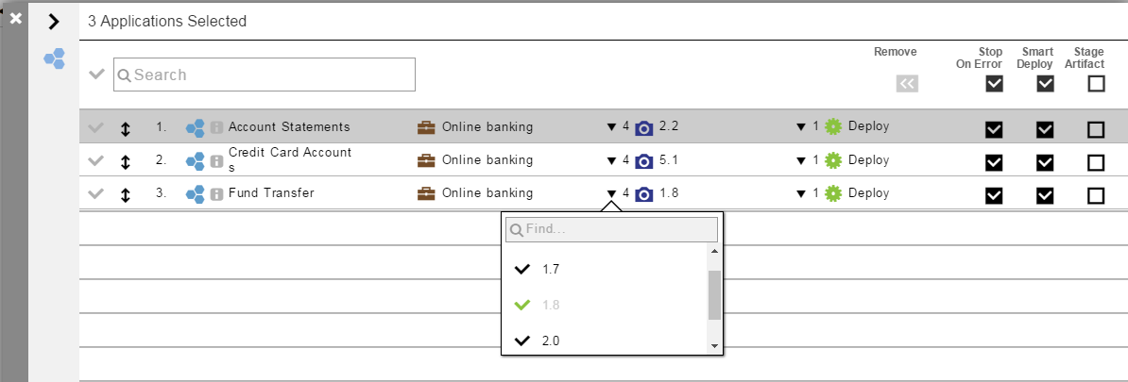
Release Applications and snapshot versions

Slide 8
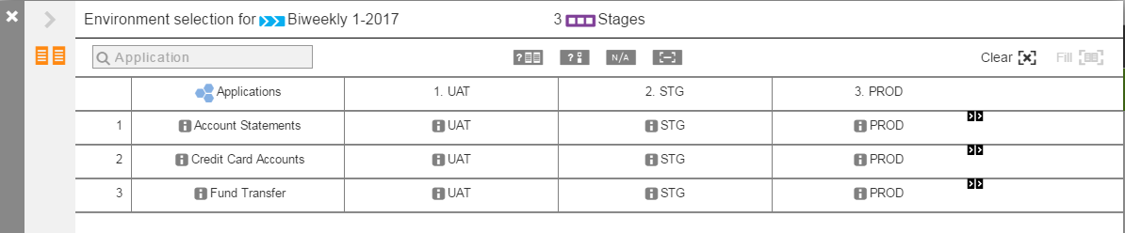
Release Environment Mapping

Slide 9
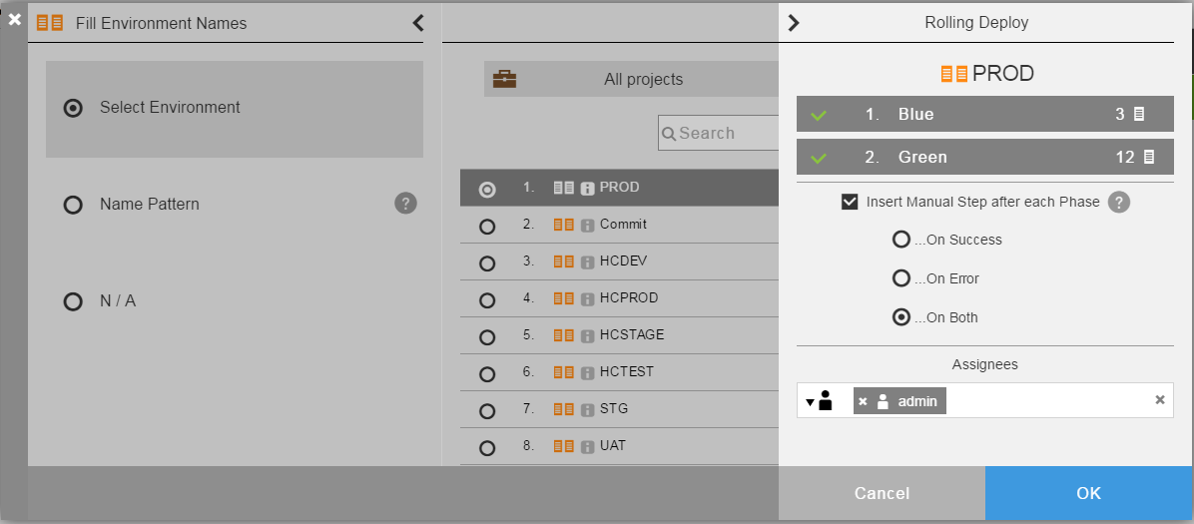
Rolling Deploy Configuration

Slide 10
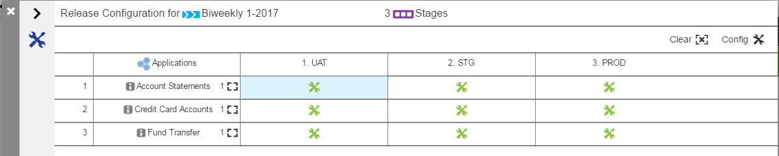
Per-environment configuration parameters

Slide 11
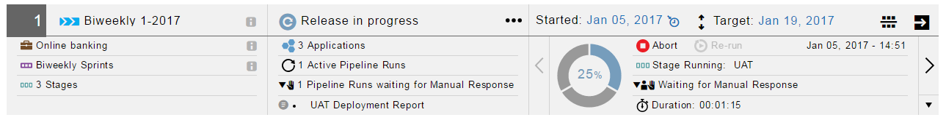
Run a release

Slide 12
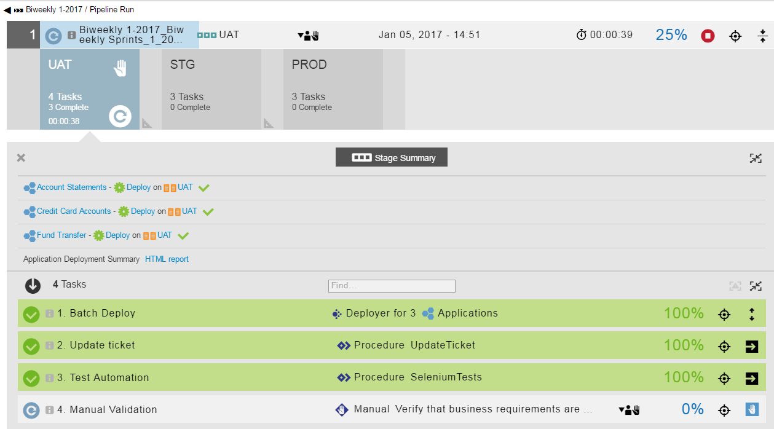

Slide 13
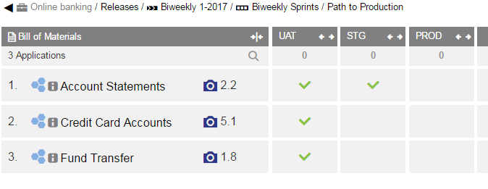
Inflight inventory

Slide 14
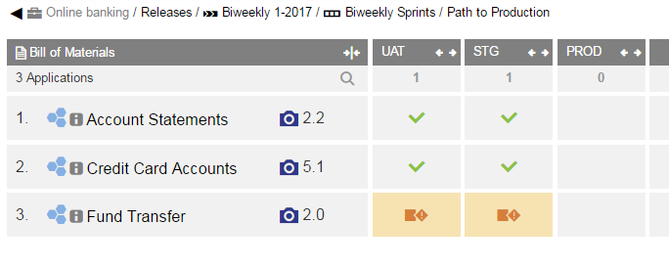
After changing a target version

Slide 15
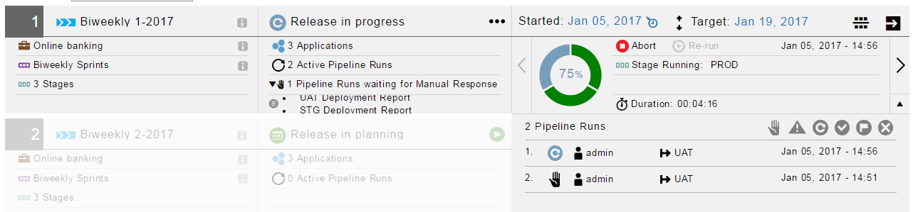
After running another pipeline

Slide 16
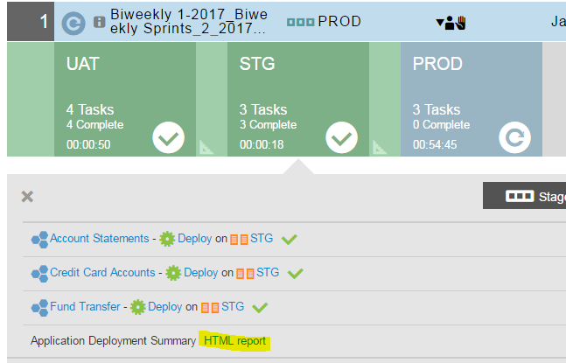
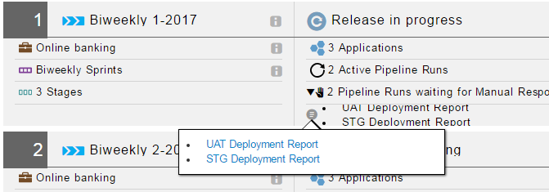
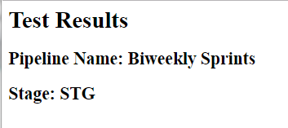
Automation Test results – dummy data available from pipeline and release

Slide 17
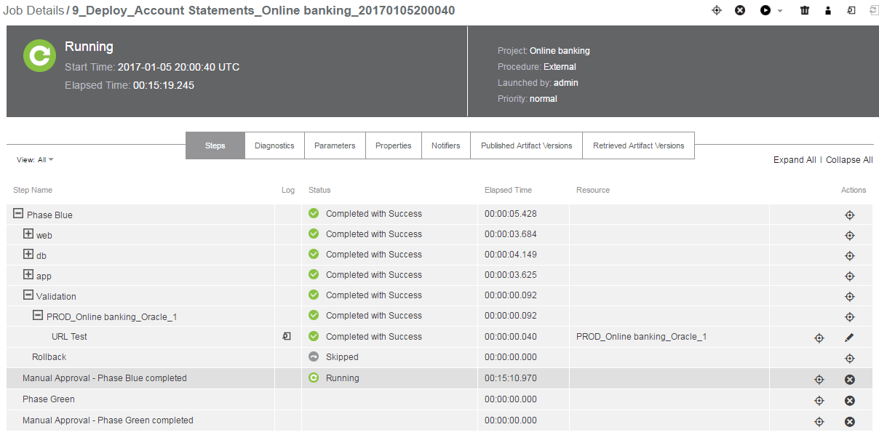
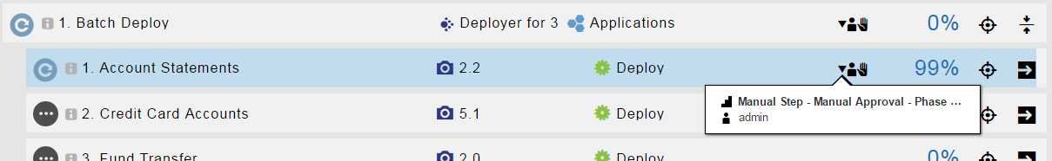
Waiting for rolling-deploy approval

Slide 18
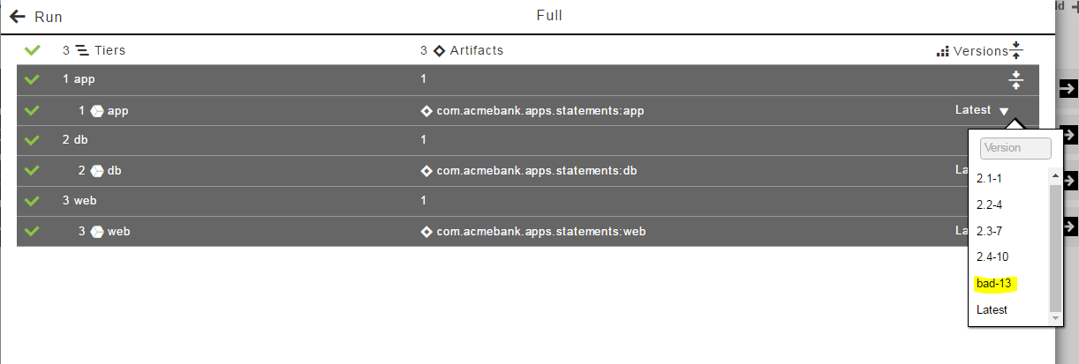
Rollback – Run a deploy with a “bad” artifact

Slide 19
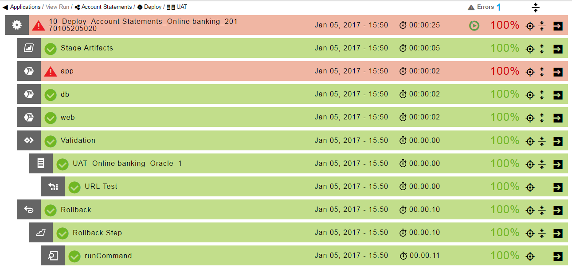
Deploy will fail and attempt to redeploy last good

Slide 20
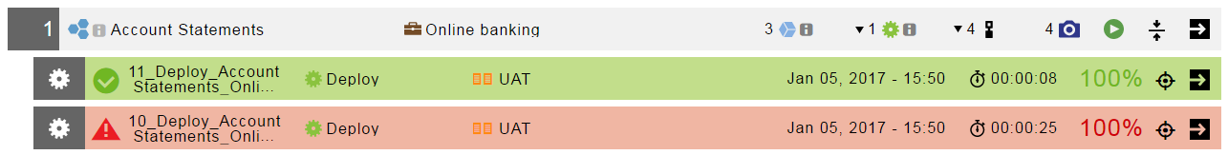
Error and Rollback deploys

Slide 21
Create Your Own Models

Slide 22
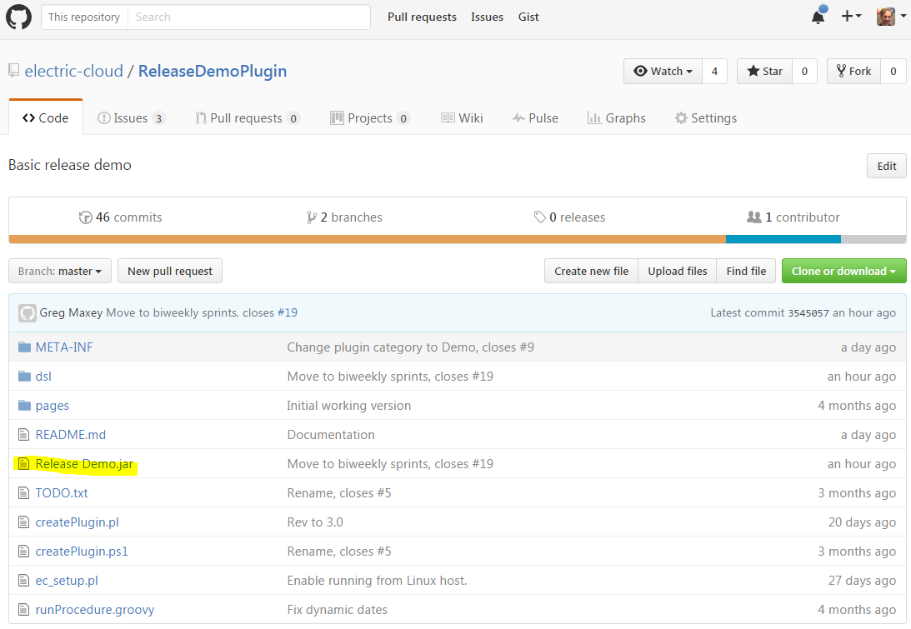
Get the plugin from github

Slide 23
Creating your own Release models
Two choices
Run the procedure, customize through parameters
Edit and run the supplied DSL

Slide 24
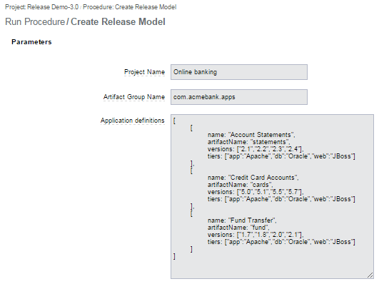
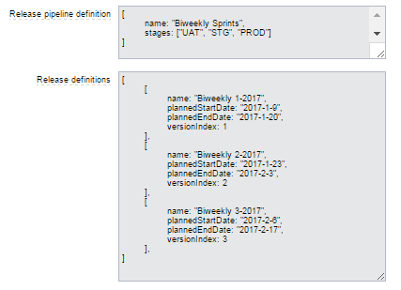
Procedure

Slide 25
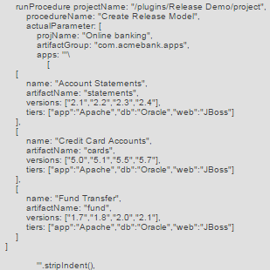
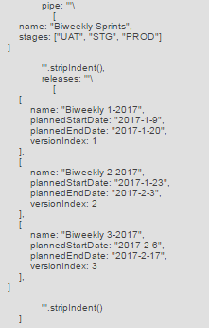
DSL – Template in plugin property dslRunProcedureTemplate

Slide 26
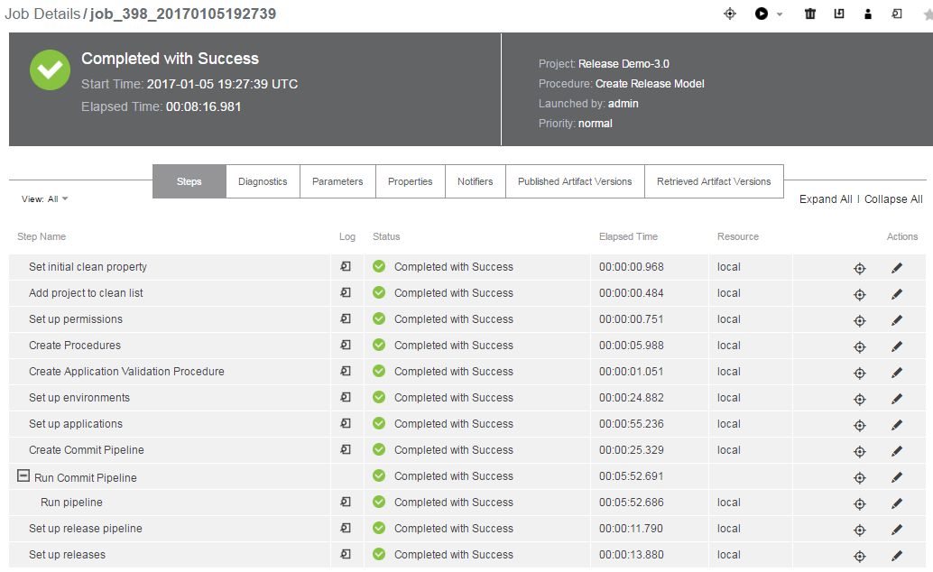
Object-creation job

